Slide 1

Grayhawk HOA
2023 Annual Meeting
Tuesday December 5, 2023
https://www.GrayhawkFrisco.com
Copyright ©2023 Grayhawk Association of Homeowners, Inc.

Slide 2
Agenda
Call Meeting to Order / Verify Quorum
Introductions
Proof of Notice of Meeting / Waiver of Notice
2022 Annual Minutes
Sgt Stephen Byrom - Frisco Police Dept
Financial Review / IRS Revenue Ruling 70-604
2022 Review
2023 Association Outlook
Election
Announcements
Adjourn Meeting
https://www.GrayhawkFrisco.com
Copyright ©2023 Grayhawk Association of Homeowners, Inc.

Slide 3
2023 Board
 |  | Years on Board
President | John Beck | 3+
Chairperson | Suzanne Johns | 3
Treasurer | Brad Boercker | 3
Secretary | Tinika Draper | 3
VP | Jeff Denman | 2
VP | Alex Nestor | <1
VP | Michael Rosenfeld | <1
https://www.GrayhawkFrisco.com
Copyright ©2023 Grayhawk Association of Homeowners, Inc.

Slide 4
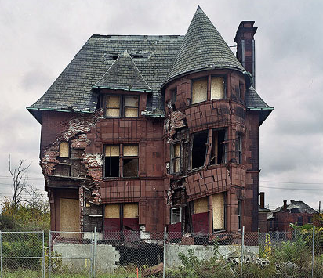
Architectural Control Committee
Our ultimate goal is to maintain our property values
  It is your responsibility, as a homeowner of an HOA, to obtain approval for exterior changes before the project is started. This is per the Governing Documents all homeowners agreed upon when purchasing their home.
  As our association ages, our standards must always be evolving
aka:
ACCC
Association Covenants Control Committee
ARC
Architectural Review Committee

Slide 5
Architectural Control Committee
Why Submit an ACCRequest
The ACC process helps to keep an ongoing record of the exterior changes on the property, for current and future property owners
Have you received a Compliance notification?
  To avoid headaches, worries and fines, submit your ACC request to get the proper approval.
  Prior to your project is your best practice. The Committee are volunteers. Please allow 30 days for review of your submission.
  Grandfathered project. Submit your already completed projects.
Do not assume approval if you see a neighbor’s property with the exterior project.
  You must submit for approval for all exterior projects per Governing Documents.
  Each property is different and has different considerations. (Some exterior changes might not have been approved. That neighbor could be is bad-standing with the HOA.)

Slide 6
Architectural Control Committee
Your Right to an Appeal
If you receive a denial on your ACC request, you have the right to an appeal
Appeals are directed to and voted on by the Board of Directors, not the ACC
Your written appeal must be submitted within 30 days
Submit your written appeal to the Board of Directors and SBB Management
  Belinda Cogburn - B.Cogburn@sbbmanagement.com
  Betty Crudden - B.Crudden@sbbmanagement.com
  Board of Directors - Board@grayhawkfrisco.com
Denied due to Insufficient Information is NOT a denial to your ACC request. This is a response either from SBB or the ACC committee asking you to re-submit your request with more details. It is a CLOSED response and requires a new ACC submission to proceed.

Slide 7
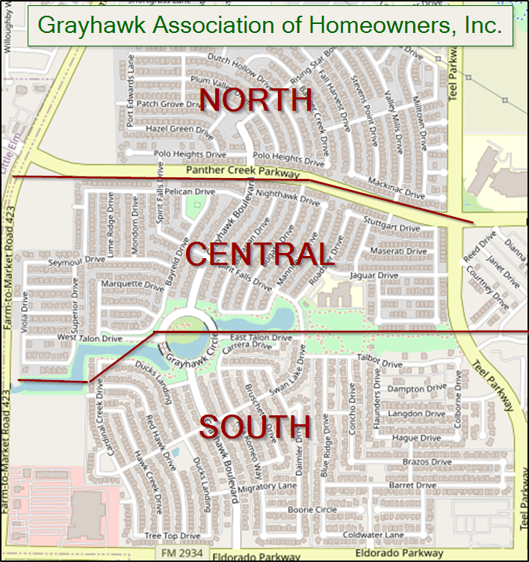
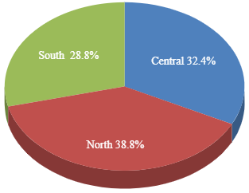
ACC Submissions
October 2022 - September 2023
ACC Requests Submitted: 372 ACC forms received: down from last year by 26
ACC Decisions Made: 409 down from last year by 100
Approved: 253 down from last year by 74
Denied: 13 (6) denied and (7) denied/closed by ACC for more information
Closed: 50 submissions closed by SBB
Avg # of Days for ACC Decision: 5.0 days
Avg # of Days from start-finish for the homeowner: 8.0 days
Per Governing Documents, the ACC Committee has 30 days for review.

Slide 8
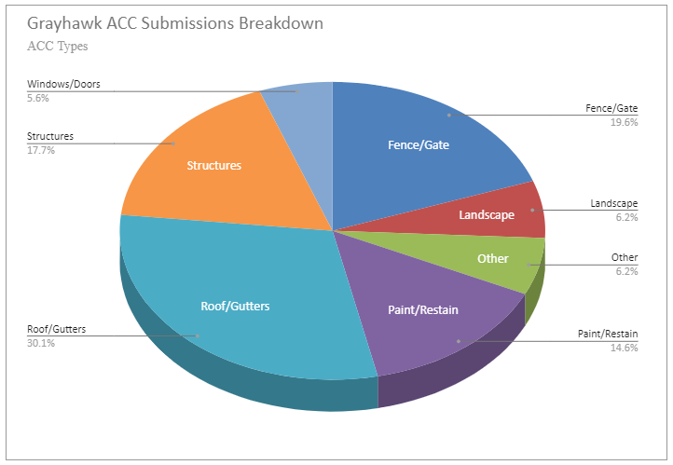
Architectural Control Committee

Slide 9

ACC - Want to Learn More
Volunteer!
The ACC Committee is a greatly way to start
  Helps with your most important asset… your home
  A great place to start if interested in a position on the Board of Directors
  Fulfilling the need for to help your neighbors

Slide 10
Beautification
Continued focus on repairs and needed maintenance
Started the Beautification Committee
  Have 7 pages of items to address, improve, add
Removed the diseased Leyland Cypress Trees
Repaired Roofs on Both Pool Houses
Repaired, replaced, added stone walls at Panther Creek & Grayhawk Blvd
South Pool
  Replastered
  Replaced furniture
  Installed new landscaping

Slide 11
Beautification
Repaired plumbing at both pools
Cleaned, restriped pool parking lots
Trimmed all tree canopies surrounding the ponds
Replaced 12 irrigation controllers (1990 technology) with smart controllers
  saved 33% on standard cost
  payable over 3 years
  able to monitor, adjust, and diagnose online
  reduce overall cost of irrigation maintenance
Total outlay - Approximately $300,000

Slide 12
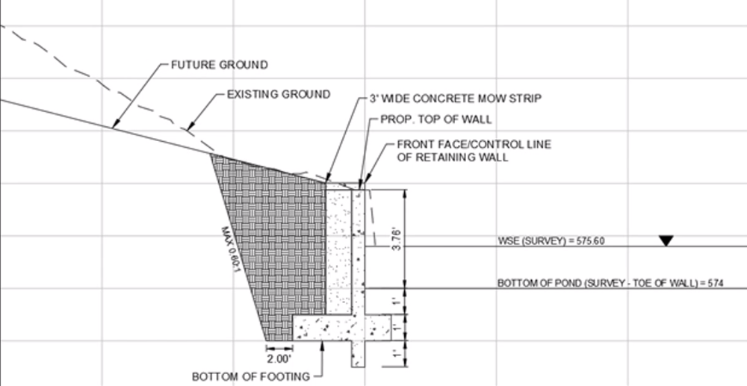
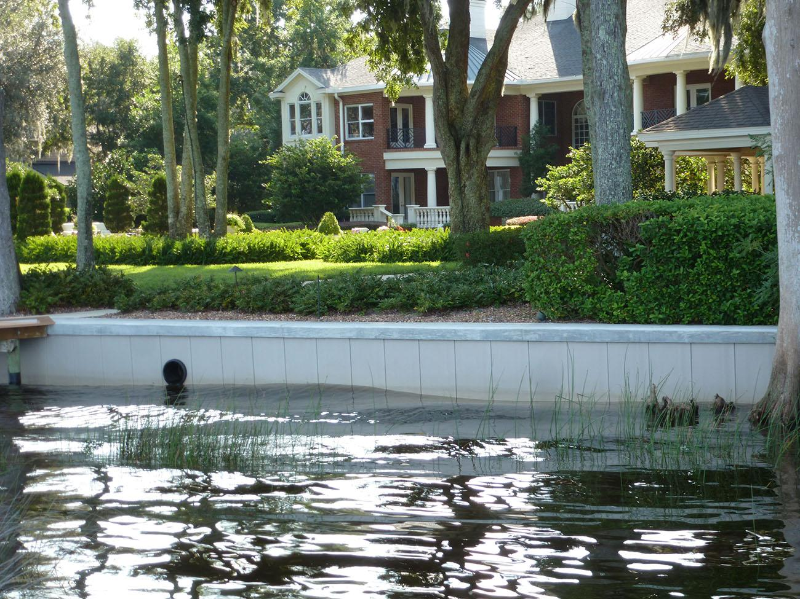
Hill Remediation

Slide 13
City Liaison / Safety
Started Safety Committee
Kickoff meeting held for Neighborhood Watch Program
Attended numerous City Planning Meetings
Worked with City of Frisco Police Department to bring additional patrols into the neighborhood
Crime stats - 10/17-12/4 (6 total incidents)
1 - Burglary of vehicle
2 - Assaults
1 - Robbery
1 - Theft
1 - Fraud

Slide 14
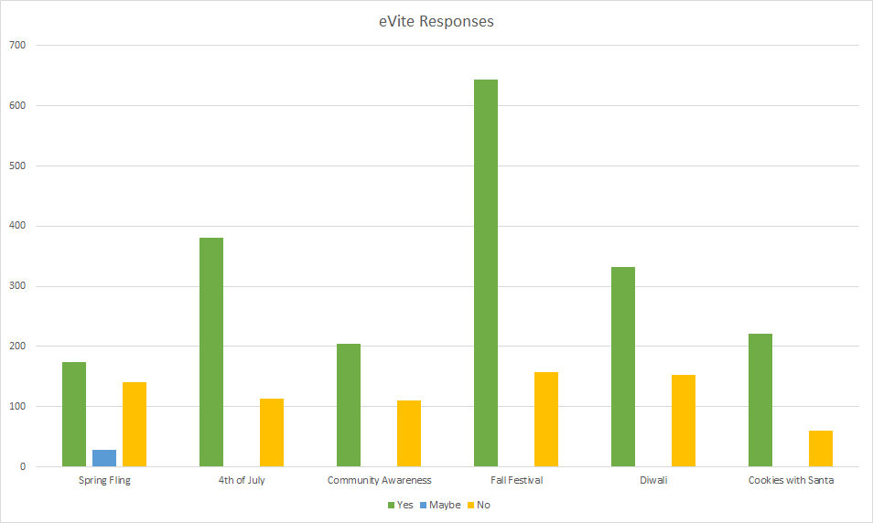
Communications
Completed Google Workspace Migration
evite - 6 events

Slide 15
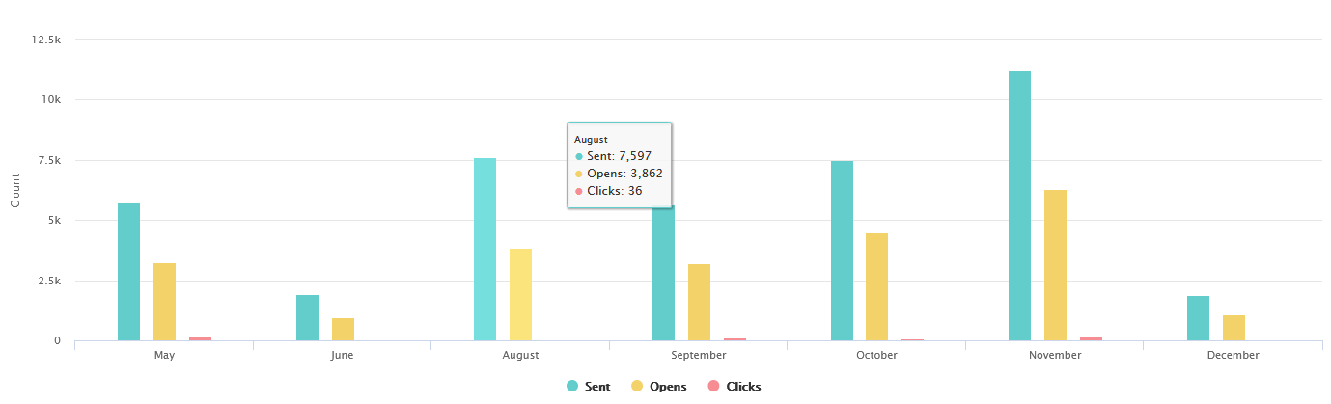
Communications
20 Maillings to Homeowners in 2023
Best open & clicked on: Grayhawk Quarterly - Spring 2023
  65% opened the email, 12% clicked a link for more information
  Average open: 52%
Average email open is 962 out of 1727
If you haven’t already registered for the website (and thus the emails), please visit https://GrayhawkFrisco.com/

Slide 16
Social / Holiday Year in Review
Thank you to the volunteers who put on these and other events in the neighborhood:
Anand Krishnan | Bill and Marcie Crume | Sue Beck | Tinika Draper
Sharon Swanson | Cristi Van Hoff | Michelle Leeper Brewster | Joy Deerfield
Rose and Mike White | Chass McAtee | Amrita Mandpe | Sowmya Anoop
Elyse Jerome | Adrianne Hudson | Patti Brown | Terry Laubacher
And all of the homeowners that have donated their time, books, baked goods, and much more! Without your help none of this would have been possible!
Lone Star High School Volunteers have been essential for making these events happen

Slide 17
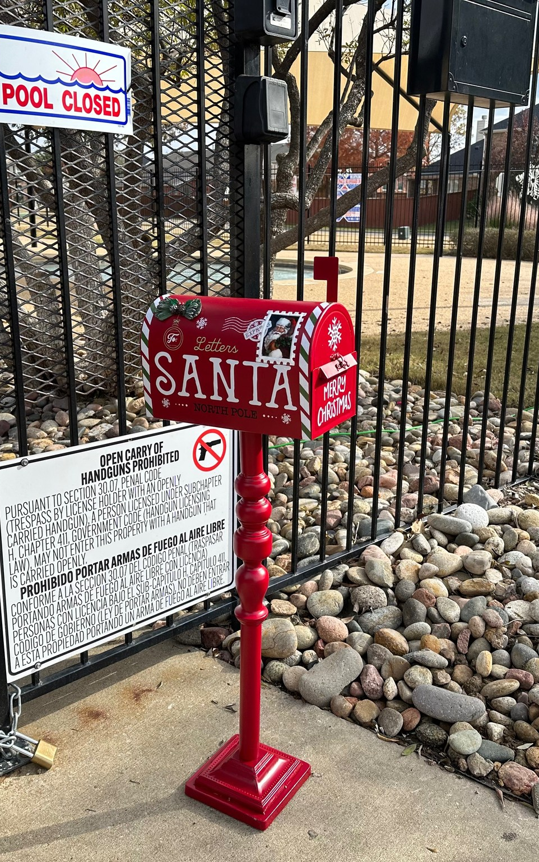


Social / Closing Out the Year
Letters to Santa
Santa Meet and Greet
Light up Grayhawk

Slide 18
Social / Holiday - 2024 Planning
Major Events
Saturday, Mar 23rd - Spring Fling
Saturday, Oct 26th - Fall Festival
Saturday, Nov 2nd - Diwali
Smaller Events
Saturday, June 29th - 4th of July Parade
Saturday, May 4th - Spring garage sale
Saturday, October 5th - Fall garage sale
Saturday, May 11th - Pool opening party at both spots
Chalk the Block/Kid Vendor Day
Grayhawk Vendor Day
Christmas Lights Contest
Halloween decorating contest
Saturday, April 20th - Movie Night (2x)
Community Awareness Night (maybe late September)
Clean It and Green It
Ambassador Program - ongoing
Holiday neighborhood crawl/caroling
December 14th - Visit/pics with Santa
Monthly farmers market (like food trucks possibly)
Back to school giveaways
Grayyhawk themed Scavenger hunt
Themed pool parties - twice a month
Puzzle night
Chili cookoff (maybe during fall festival)
Trunk or treat
End of year volunteer party

Slide 19
Payment Solution Initiative (PSI)
New Automated System for Delinquent Accounts
Association Demand Letter
Final Demand Letter
Intent to Lien
Notice of Lien Filing
Collection Warning Alert and DAP
Each step includes letter/certified letter to homeowner and payment plan option

Slide 20
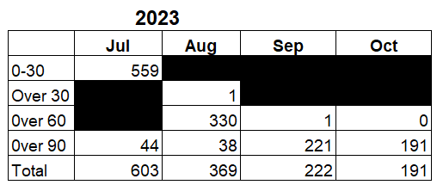
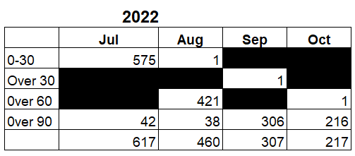
Finance-Collections
Since implementation of PSI we have seen a significant decrease in delinquent accounts, which is better for both the Homeowners and the Association.

Slide 21
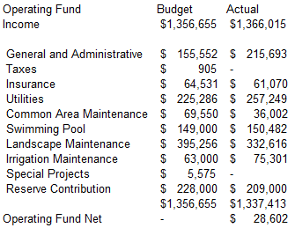
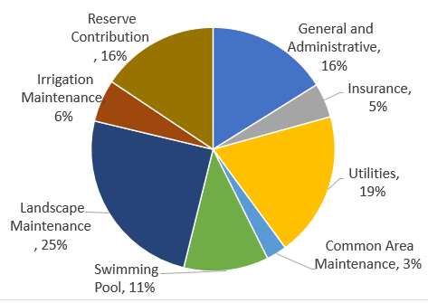
Finance-Operating

Slide 22
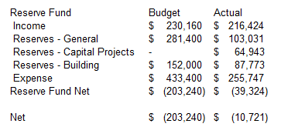
Finance-Reserve

Slide 23
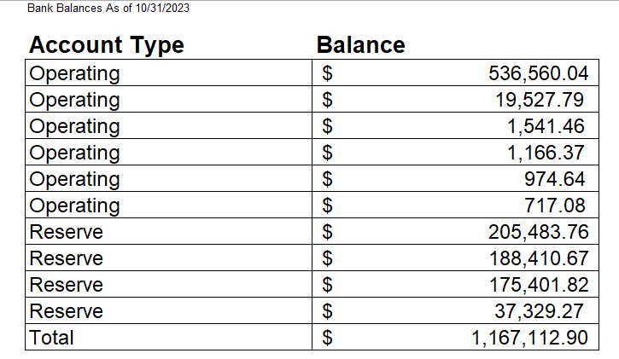
Finance-Bank Accounts and Cash

Slide 24
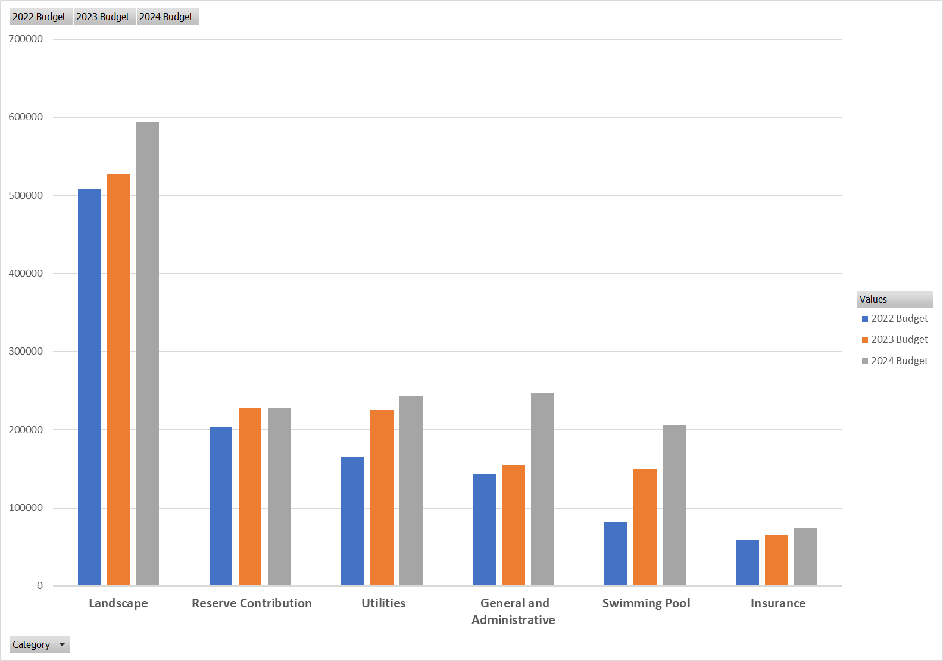
Finance-2024 Budget
Swimming Pool includes Frisco PD Patrols
G&A includes Social at 1.7% rev

Slide 25
Violations
Process
First Warning
Final Warning
PC209 Certified Letter
Violation Fine
Open Violation Summary
456- Landscaping
82-Maintenance
24- Signs
72- Unsightly Items
30 - Vehicles/Trailers

Slide 26
Real Estate
Current Homes Active on the Market – 11
Market time thus far is 8 days to 176 days
Highest priced home is 12558 Grayhawk Blvd at $700,000
Active Option Contracts – 2 (means these are in inspection period, can kick-out if they don’t like what they see)
  Days on Market 118 days and 200 days
Pending – 2 (means most likely will close)
  Days on Market 81 and 211
Closed sale – 1 on Fall Harvest for $560,000
Home values in Texas rose by 48.46% in the last 5 years. Home sales decreased by 10.1% in September 2023 YoY and the mortgage rate climbed to 7.84%! So, sellers are seeing challenges while homebuyers (IF THEY CAN AFFORD THE CURRENT INTEREST RATES or pay cash) are seeing home prices dip by at least 10-15% from this time last year, making a purchase more likely. Interest rates are expected to remain in the 7-7.75% range until mid-summer 2024. Even then, we don’t expect rates to be below 6% again for another 1-2 years.

Slide 27
2024 Outlook
New Board Will Set Priorities
Continue to encourage homeowner involvement
Build out Committees
Obtain More Volunteers for Activities
Continued focus on maintenance and repairs
Contract for Reserve Study
Increase Items contained in reserve
Currently reviewing 3 Proposals
Hill Remediation
Move to resolution
Financial arrangements put in place
Release Bid Specifications
Release Contracts
27

Slide 28
Thank you
Volunteer Form
https://www.grayhawkfrisco.com/resident/volunteer-form-new.aspx
28

